Slide 1



Hospitality
less ordinary

Slide 2

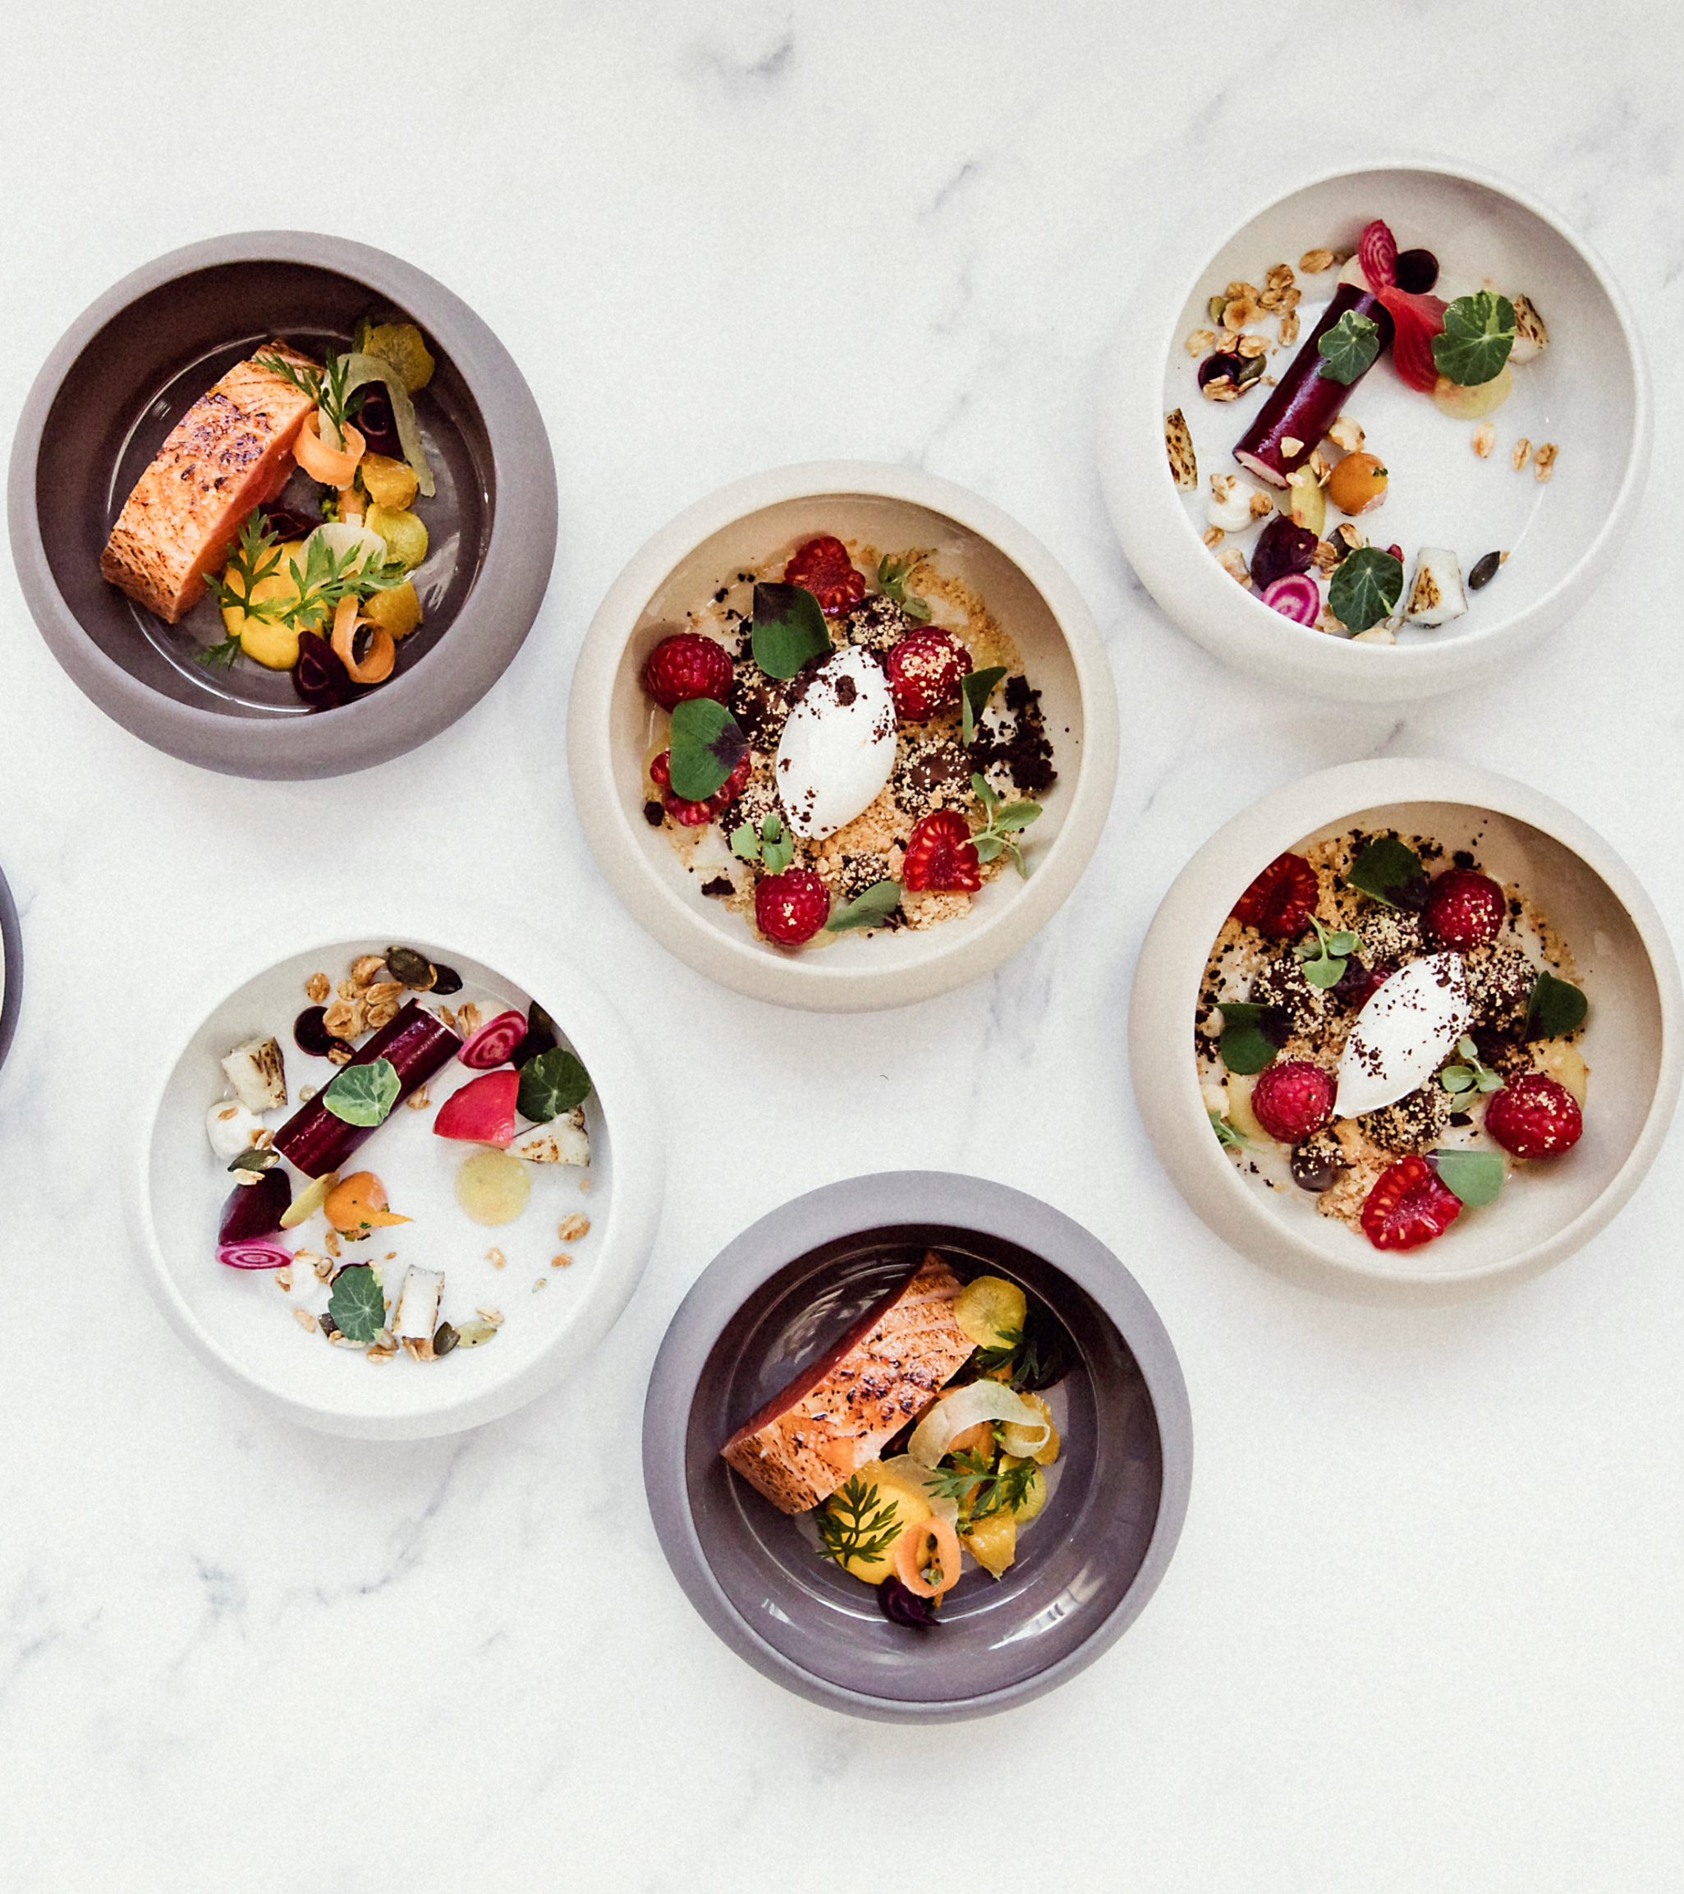
Your Contacts
Our Catering Manager, Carol Watson, and her dedicated team would be delighted to assist you in making your event a memorable one.
You can contact them through either dialing 0131 668 8231 or emailing roekitchen@stfc.ac.uk Monday to Friday 8am – 4pm.
We ask that you contact us, for any bespoke requirements and we will be happy to build a package around your budget and vision.
If you, or any of your guests have any specific allergy or dietary requirements we ask that you let us know in advance, preferably whilst making your booking.

Slide 3

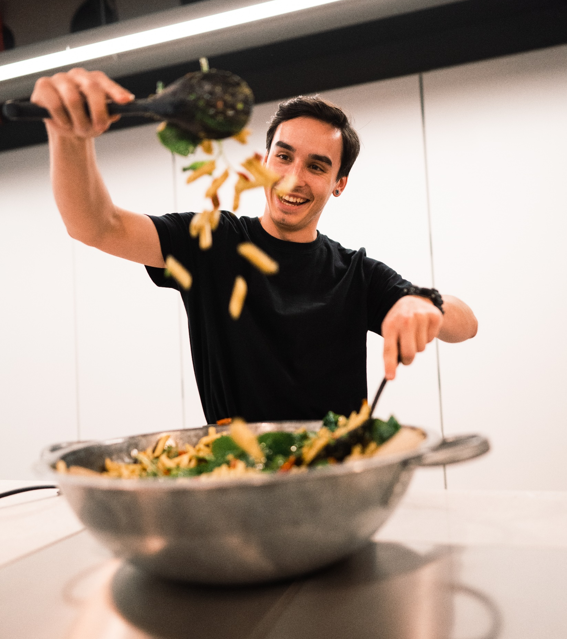
Ordering
Selecting your menu
When placing your order, please advise us of any allergies or dietary requirements.
Placing your order
Once you have made your selection, please place your order with our catering team by emailing roekitchen@stfc.ac.uk or calling
0131 6688231
Order Deadlines​
As a minimum, we do require the following notices for all hospitality orders:
  2 working days for Morning, Classic Sandwich Lunch, All Day Snacking. Cut off time 10:30 am.
  3 working days for Premium Sandwich lunch, Buffet Bites, Mini Buffet Bites. Cut off time 10:30 am.
  A minimum of 5 working days for Formal Dining, hot and cold buffets, Canapés, Bespoke menu.
Cancellations
In the event of cancellation within 2 working days of the booking, you may incur a charge to cover the cost of any food waste.
Dietary Requirements
For those with special dietary requirements or allergies who may wish to know more about the food or drink ingredients used, please don't hesitate to ask a member of our team.
Special Events
If you are planning a special event and would like to discuss the details with us, please contact roekitchen@stfc.ac.uk
Hospitality Hours are
Monday to Friday
8am – 4pm
Any bookings outwith these times will have a labour charge attached. Bookings can also be made for evening functions
For numbers over 20 people additional labour charges will apply. Please chat to our hospitality team who will advise.

Slide 4

Beverage
Tea and Coffee A selection of Fairtrade teas and freshly filtered coffee | £1.25 per person
Tea and Biscuits A selection of Fairtrade teas and freshly filtered coffee with a small packet of biscuits Tea and Cakes A selection of Fairtrade teas and freshly filtered coffee with a small cake or macaroon | £1.75 per person £2.50 per person
Alternative milks can be provided on request, please note there will be an additional charge for this.
Still or Sparkling Water 1L bottles, serves 5 | £2.20
Fruit Smoothies​ Berry Burst Pineapple Sunset Supergreen | £2.20 per person Min 5 order
Fruit Juice Jugs Apple, Orange or Cranberry | £2.20 per litre, serves 5
Soft Drinks 330ml | £1.40 Each
Sparkling Elderflower Presse Per Jug, serves 5 | £3.95 Each
Please note all prices are not inclusive of VAT. All food orders will be cleared within 2 hours.

Slide 5

All Day Snacking
Biscuits Shortbread Tunnocks Treats Scones Danish Traybakes Selection of Muffins Macaroons Mini donuts Mini fruit skewer | £0.50 £0.50 £0.55 £1.20 £1.45 £1.80 £1.85 £1.85 £1.20 £1.50
Please note all prices are not inclusive of VAT. All food orders will be cleared within 2 hours.

Slide 6

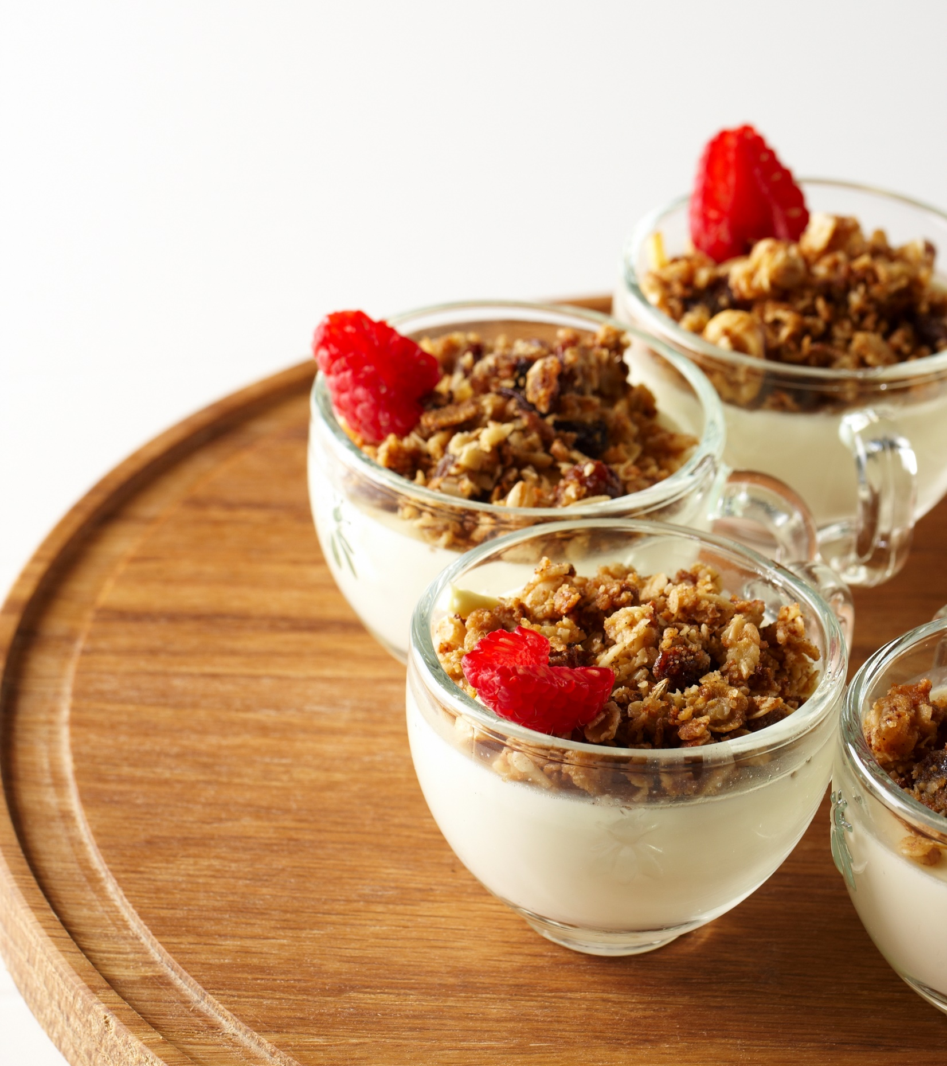
Yoghurt Pots
Greek yoghurt, blueberries, mint and honey | £2.95
Greek yoghurt, apple strudel compote and granola | £2.95
Soya pots available VE
 | £XXX
Morning
Available from 8am till 11am.
Mini Bites | £1.80 per person
A selection of freshly baked pastries Croissant, Butter & Preserves Home baked Scone with Butter & Preserve | £0.94 per person
 | £1.96 each, 1 roll per person
Seasonal Fruit platter | £2.80 per person
Please note all prices are not inclusive of VAT. All food orders will be cleared within 2 hours.

Slide 7
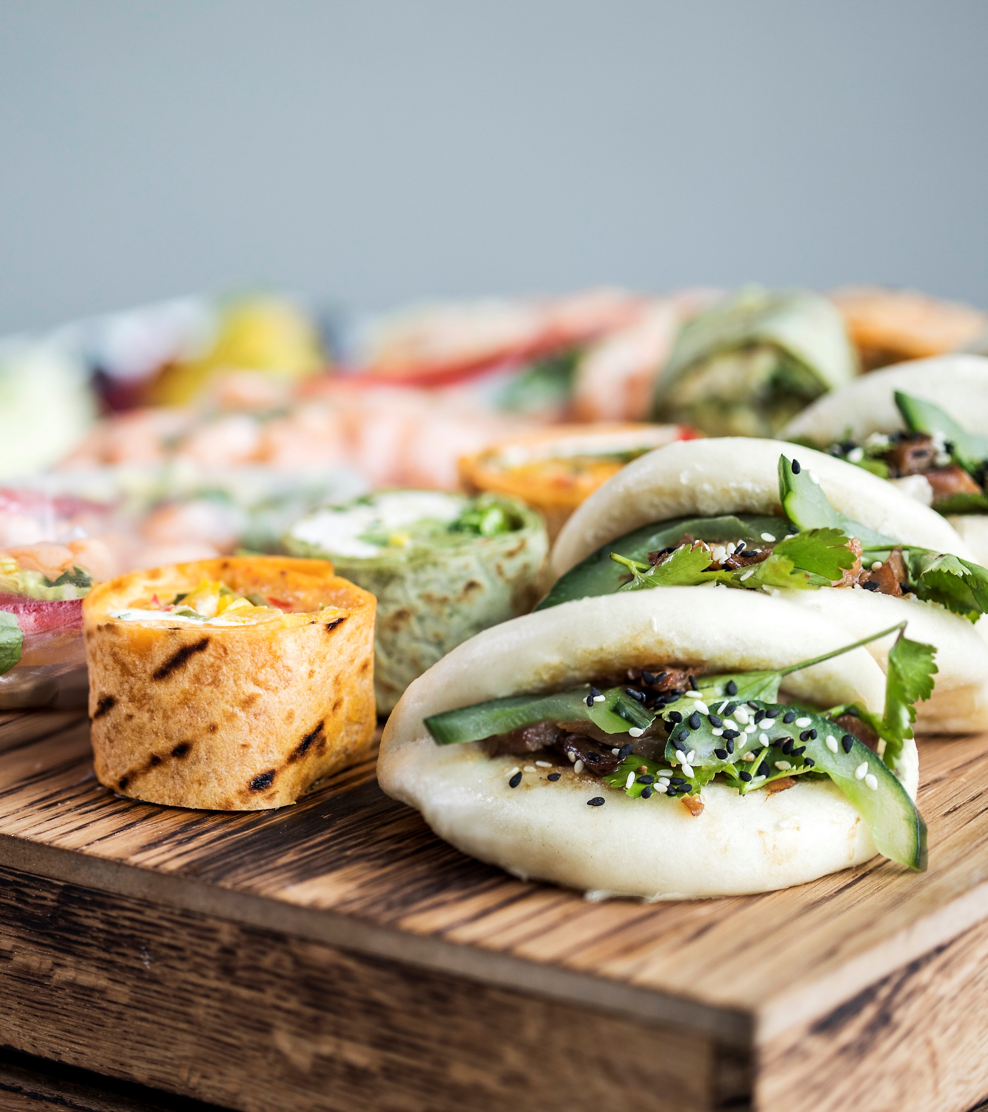
Lunch
Available from 12 – 13.30pm.
All platters will have a selection of meat and vegetarian fillings unless otherwise requested. All sandwich lunches are served with fresh fruit juice, water and mini fruit skewers. We allow for 1 round of sandwiches per person.
Sandwich Lunch
Please choose one of the below | £0.94 per person
A classic sandwich lunch | £5.15
A Premium selection of premium bread sandwiches, rolls, wraps, and bagel | £5.95
Add Ons
Fresh Seasonal Salad, using local produce | £2 per person
Chef’s Soup of the day, hearty and warming using fresh local produce | £1.20 per person
Please note all prices are not inclusive of VAT. All food orders will be cleared within 2 hours.

Slide 8
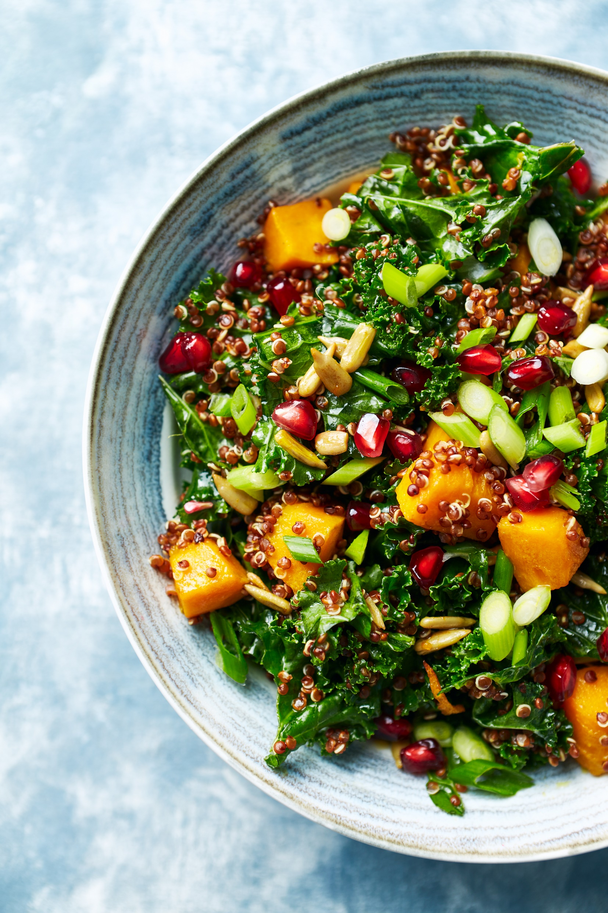
Buffet Bites
Select any of the following options to add on to your sandwich lunches if you’re looking for something more substantial or to add variety to your lunches.
Please
Meat £2.00 per person for 3 bites
Mini Sausage rolls Tikka Chicken Kebabs with Mint Yogurt Honey Glazed Chipolatas Haggis Bon Bons with a roast tomato Chutney Mini Lamb Koftas
Vegetarian £1.85 per person for 3 bites
Vegan Sausage rolls Chickpea & Spinach Falafels with a pepper humus Bhaji Bites, lemon & coriander Aioli Vegetarian Spring Rolls with a sweet chili dip Vegan Bruschetta with tomatoes, basil & onion Mac & Cheese bites
Please note all prices are not inclusive of VAT. All food orders will be cleared within 2 hours.

Slide 9
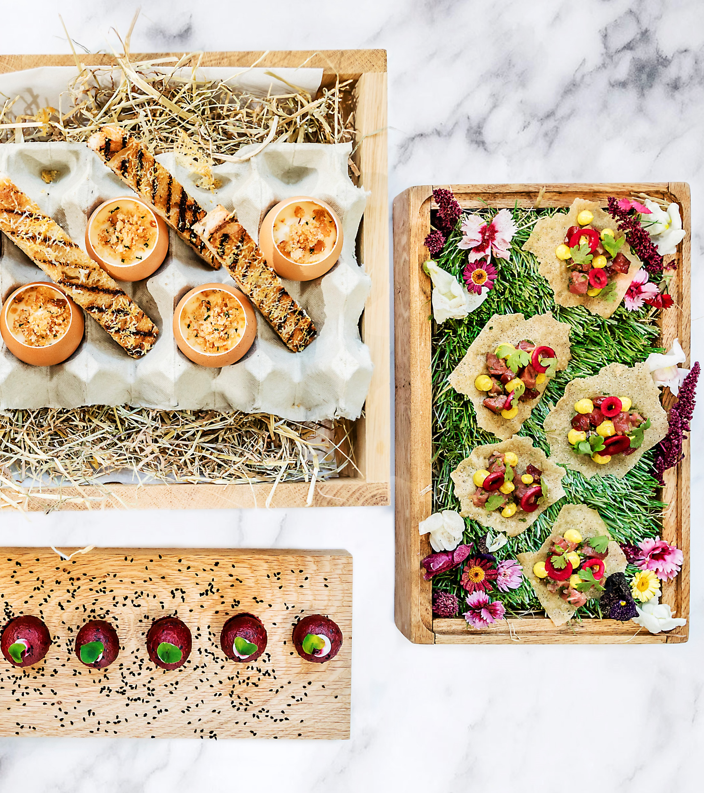
Mini Buffet Bites
Finger Food | £7.55 per person
Minimum of 8 guests ​
Canape Selection Burgers with coriander-yuzu cream, sugarsnap peas, teriyaki sauce, grilled sesame seeds; Vegetarian club sandwich Onion cakes Tomato Financiers with Ricotta cream, Mozzarella cheese ball, marinated tomato Blinis with roasted peppers and pepper cream Spinach Cakes with Mascarpone cream, broad beans, sugarsnap peas Mini Quiche Assortment chicken & vegetables, ham & cheese and spinach & cheese Selection of Macaroons Including Vanilla, Lemon, Raspberry, Coffee, Pistachio and Chocolate Served with Fresh Fruit Juice and Water
Please note all prices are not inclusive of VAT. All food orders will be cleared within 2 hours.

Slide 10
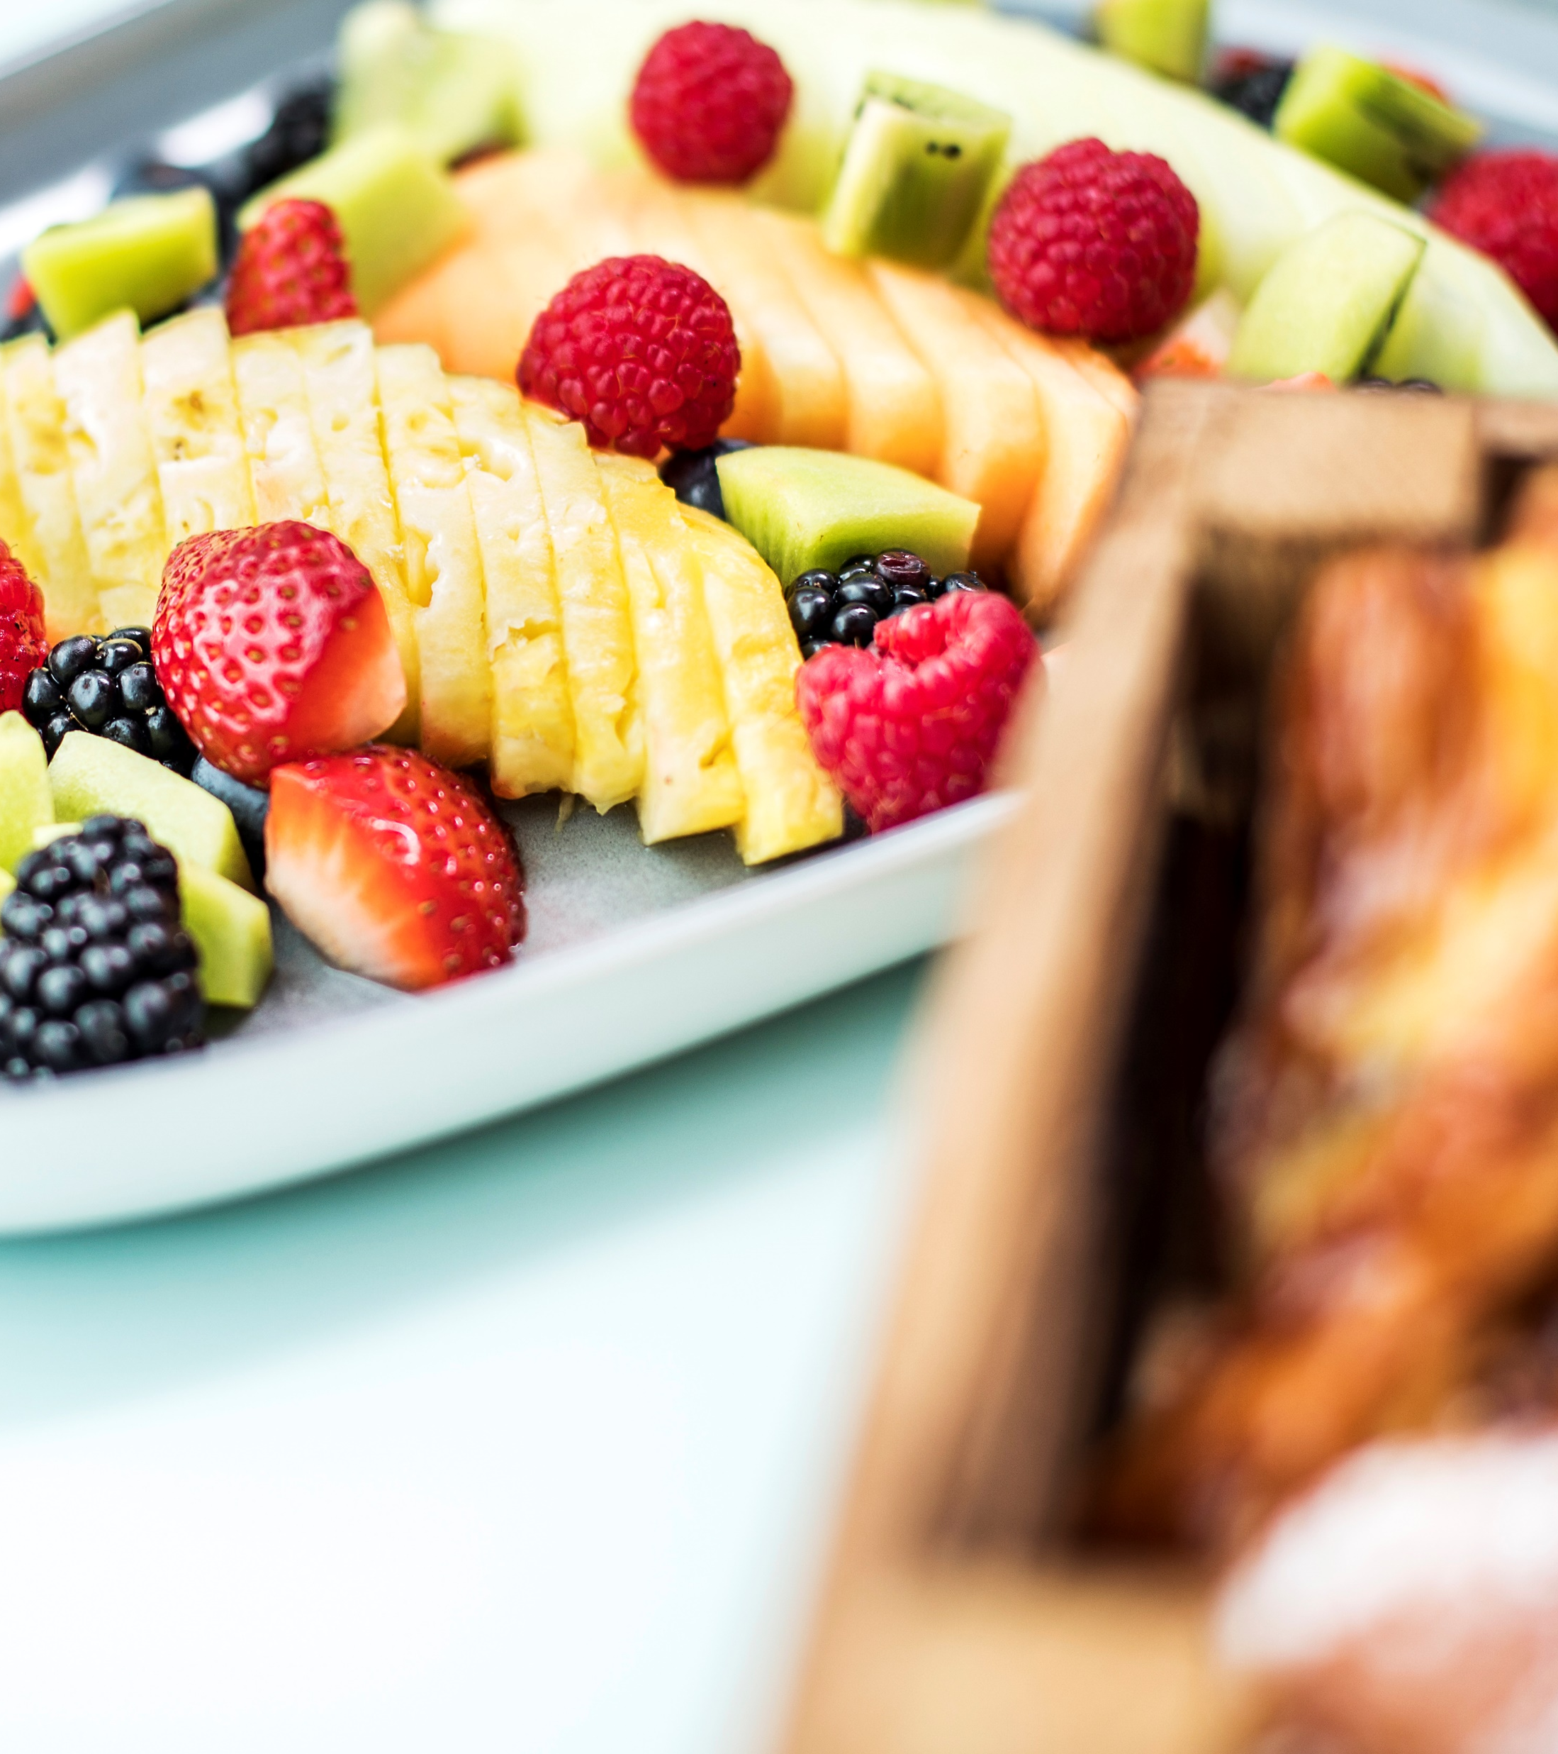
Sweet Treats
£3.25 per person
Please choose any 2 from the following items
Raspberry Red Velvet Tray Cake Vegan Cherry Bakewell Loaf Chocolate Fudge Cake
2x Brownie Tray Bake 2x Strawberry Cream Slice 2x Peach Cream Slice
2x Apple slice with butter crumble
Cheese Board £3.95 per person, 5-person minimum order Selection of Cheeses served with Scottish Oatcakes, crackers, chutney and grapes
Please note all prices are not inclusive of VAT. All food orders will be cleared within 2 hours.

Slide 11

Bespoke
Fancy something a bit different?
Please speak to our Hospitality Team.​
​
From bespoke, seasonal fine dining to large-scale themed events, our talented Chefs will be delighted to work with you to create bespoke menus for your meeting or event.

Slide 12
Information
  Dietary Requirements
  Please let us know if any of your guests have any allergies or intolerances. ​
  We use numerous ingredients in our kitchen ​to produce fresh and seasonal products.​
  Our product range is produced using shared equipment in a busy environment where we regularly change our menus and recipes. As such, some products may not be suitable for those with severe allergies.​
  Please rest assured that one of our Allergy Champions will be on hand to help your guests make an informed decision.
  Please note the following
  Our Food Safety Policy guidelines suggest that food should be consumed within two hours of delivery. ​
  All event requests are subject to labour charge and equipment hire charge.
  All prices quoted are not inclusive of VAT​
  Contact
  Should you require any assistance, please contact roekitchen@stfc.ac.uk

